Slide 1

IRT Analyses Using the Statistical Software R
EALTA, Dublin 2019
Steffen Brandt

Slide 2
Goals
Calculating a score for the PISA 2015 reading assessment, trying to get as close as possible to the original ones.
Using the same approach to calculate scores for your personal data sets.

Slide 3
Structure
Getting Familiar with R and RStudio
Data Preparation and Exploration
Estimation of a Unidimensional IRT Model
Revision of Item and Test Characteristics
Estimation of Individual Ability Scores
Getting More Reliable Scores Using an IRT Model with Regression
Estimation of a Multidimensional Model

Slide 4
What is R?
An “interpreter” language
Developed by statisticians (Python, e.g., was developed by computer scientists)
Together with Python the most popular data science language
Notes:
The largest variety of statistical packages
Huge comunity

Slide 5
Why should I learn R?
It’s Open Source!
Today, data preparation and analysis skills are critical success factors in all mid to large size companies
In academia R is getting more and more the standard language for statistical analyses
It has a large community that probably already had every problem you will have.

Slide 6
Why do I need RStudio?
It is an integrated developer environment (IDE) for R that provides you:
quick access to help files, data files, and saved program code,
information about data objects currently in the working environment (data tables, variables, functions, etc.),
easy access to graphical outputs,
installation of additional function libraries (packages),
integration of version control,
and much more…

Slide 7
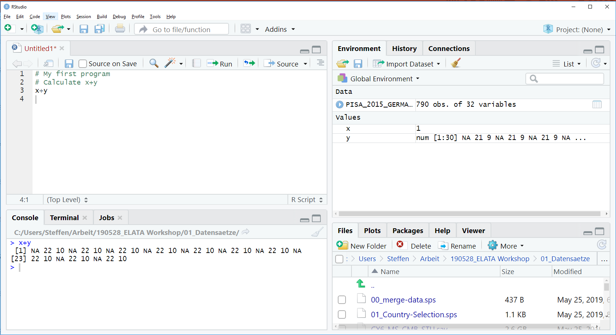
Using RStudio

Slide 8
Where do I find help?
Google!
Google
Stackoverflow
Cheatsheets
R function documentation

Slide 9
What is an R program?
A sequence of definitions
x <- 1
y <- c(2, 15, 39, 24)
or expressions
x + y
3^2/2
mean(y)
x = 1
Change the workspace environment
Generate an output
All names (for variables, functions, …) are case sensitive!
Notes:
The right-side part of a definition is an expression!

Slide 10
Tasks
Calculate the standard deviation of the vector including the numbers from 1 to 10.
sd(c(1,2,3,4,5,6,7,8,9,10))
Notes:
Look at the function documentation!

Slide 11
Functions and Packages
Are the engines of any R program
Function arguments (input data) are provided in parentheses, for example: mean(x=c(1,3,4,NA), na.rm=TRUE)
Basic functions are included in the “base” package, the function library coming with the standard installation
Additional functions can be used after installing a corresponding package from the Internet
Notes:
Look at the function documentation!

Slide 12
Tasks
Install the following packages: haven, dplyr, ggplot, tam, psych
Load the functions of each of these packages into the environment using the function library().
Try to get an idea of the type of functions that each of these packages provides.
Notes:
Look at the function documentation!

Slide 13
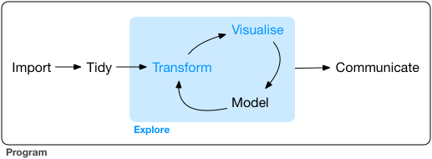
Data Preparation
(Wickham & Grolemund, 2016)
Notes:
Look at the function documentation!

Slide 14
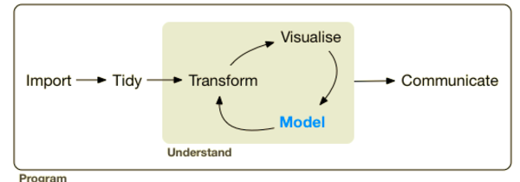
Data Modelling
(Wickham & Grolemund, 2016)
Notes:
Look at the function documentation!

Slide 15
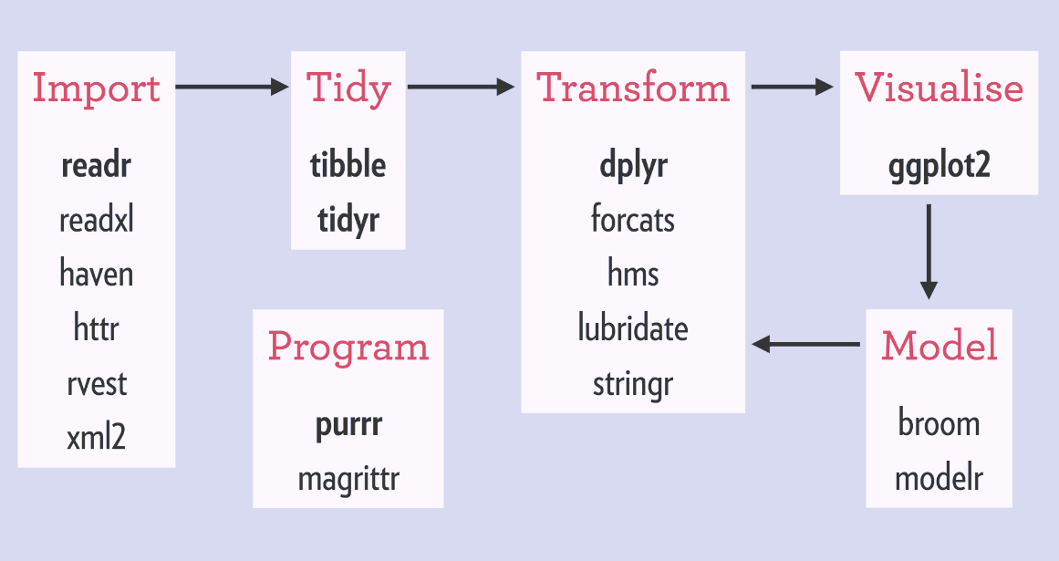
Tidyverse
(cf. https://rviews.rstudio.com/2017/06/08/what-is-the-tidyverse/)
Notes:
Look at the function documentation!

Slide 16
R Objects
An R object can be: a data table, variable, vector, function, list, graphical output, and many more
All R objects can be exported and imported to the environment using, the following functions: save(object_name, file="filename.Rda") load("filename.Rda")
Notes:
Look at the function documentation!

Slide 17
Tasks
Create a working directory for this workshop on your computer.
Download the R object starting with the name “PISA_2015” provided here on GitHub: https://github.com/steffen74/EALTA-2019-Workshop
Import the R object into your environment.
Try to get an idea of the content of the R object.
Notes:
Look at the function documentation!

Slide 18
Data Types
There are 3 basic types of variables:
boolean (TRUE, FALSE)
numeric (1.1392)
character ("text")
And various additional more specific types:
integer (12; subtype of numeric)
date ("2019-04-11"; subtype of numeric)
factor ("lower secondary", "upper secondary", …; subtype of integer)
For each data type missing values are defined as NA.
Notes:
Look at the function documentation!

Slide 19
Vectors
Via the function c() you can concatenate single data values.
All elements in a vector must be of the same type. → A vector has a unique type.
Examples: signed_up <- c(FALSE, TRUE, FALSE) city <- c("kiel", "hamburg", "berlin") distance <- c(112, 343, 235) sampleSize <- 12
Notes:
Look at the function documentation!

Slide 20
Data Tables
Data tables consist of vectors with equal length.
There are different definitions of data tables:
dataframe (base package) Standard data table, which is still most commonly used.
tibble (tidyverse package) Optimized version of data frame with focus on data preparation and cleaning.
data.table (data.table Package) Optimized for very large data tables.
Notes:
We will primarily use tibbles.
Tibble exists since 03/2016
data table exists since 04/2005

Slide 21
Example Data
Packages often include example data.
ggplot2 includes a tibble named mpg. (Fuel economy data from 1999 and 2008 for 38 popular models of car)
The dataset is invisibly imported into the environment when calling library(ggplot2).

Slide 22
Working with Data Tables
Selecting a vector/variable/column from a data table
PISA$HISCED (vector of the data table column with the name class)
PISA[[1]] (vector of the first column in the data table)
PISA[,1] (data table consisting of only the first column)
Adding or changing a vector in a data table
PISA$AVRG_ISCED <- .5*PISA$MISCED + .5*PISA$FISCED
PISA$CR055Q01S <- PISA$CR055Q01S*2

Slide 23
Working with Data Tables and dplyr
Beispiel:
PISA %>%
select (EAPREAD, MISCED, FISCED) %>%
filter (EAPREAD<500) %>%
mutate (AVRG_ISCED = .5*MISCED + .5*FISCED)
Pipe Operator: %>%
Concatenates the application of several functions into a single expression.
The function after the operator uses the result of the function executed before as its first function argument.
Allows in a more readable and very often more effective data preparation.

Slide 24
Important dplyr Functions
Select variables from a data table: select()
Reduces the data table to the variables with the given provided.
Filter cases from a data table: filter()
Reduces the data table to cases for which the given logical condition ís true.
Add variables: mutate()
Adds a new variable with name provide before the equal sign and with the value provided via the expression after the equal sign.

Slide 25
Equal and Assignment Operators
Definition of objects: a <- x
Setting function arguments: mean(x, na.rm = TRUE)
Defining new variable names when they are part of the argument of a function: tibble(var1=c(1,2,3), var2=c(1,2,3))
Comparison of objects: a == x
Do not use the equal sign (=) for the definition of objects!

Slide 26
Logical Operators
Equal: ==
Or: |
And: &
Greater or equal as: >=
Smaller or equal as: <=
The result of a logical operation is always a logical vector (or value).

Slide 27
Tasks
Select the variable HISCED from the data table and look at the output
Add a new variable HISCED_father to the data table which indicates for each student whether the ISCED level of the father is higher than the ISCED level of the mother.
Use the function table() to check on the number of respective values in HISCED_father
Use the function describe() to get an impression of the values in the data table.

Slide 28
Visualizing Data
The package ggplot currently provides the most powerful functions for graphical outputs.
Example of a histogram: ggplot(PISA) + geom_histogram(aes(x=EAPREAD))
Great source for examples including the program code: https://www.r-graph-gallery.com/

Slide 29
Why bother with IRT?
In comparison to CTT it
assumes a more realistic response pattern including probability,
provides a theory about the relationship of item difficulty and measures trait level,
provides trait level dependent reliability measure,
can “natively” deal with incomplete answers, and
provides various straightforward methods to check for item and test quality.

Slide 30
IRT Software
Facets
PARSCALE
ConQuest
mdltm
R package mirt
R package TAM

Slide 31
Why the R Package TAM?
Why R?
Open source!
All data preparation and analyses in a single software
Large community
Why TAM?
Very well maintained
Very flexible model definition
Large set of support functions
(If you used ConQuest before: proximity of the result output)

Slide 32
Estimation of a Unidimensional IRT Model
# Prepare a data set ‘resp’ including only the
# variables with the item response data
# import functions
library(tam)
# estimate model
mod <- tam(resp)

Slide 33
Tasks
Import all function libraries you need
Import the PISA data set
Prepare a dataset ‘answerData’ including only the variables with item answers
Estimate a unidimensional IRT (Rasch) model

Slide 34
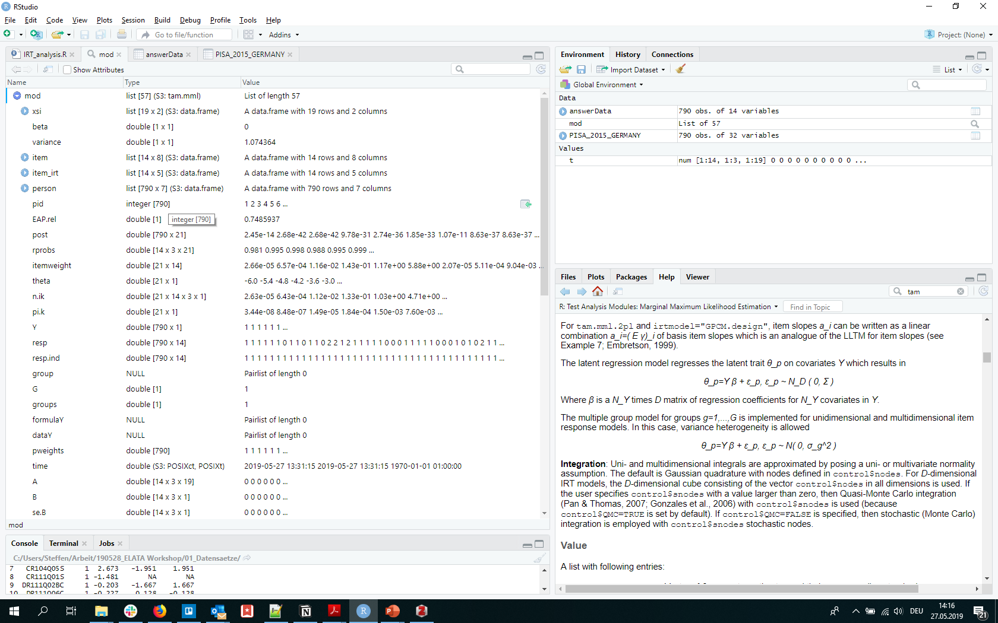
The Result Object

Slide 35
What is a List?
A list is an R object that includes a list of other arbitrary R objects
A data table is a special list object where all elements are vectors and of the same length.
Selecting elements from a list corresponds to selecting elements from a data table: mod$person mod[[1]]

Slide 36
Revision of Item and Test Characteristics
Visual check of the item characteristic curves (ICCs)
Checking item fit statistics
Checking classical test theory measures (point-biserial correlation)
Checking on differential item function (DIF)
Checking test reliability
Notes:
Start the syntax but with comments only!

Slide 37
Item Characteristic Curve (ICC)

Slide 38
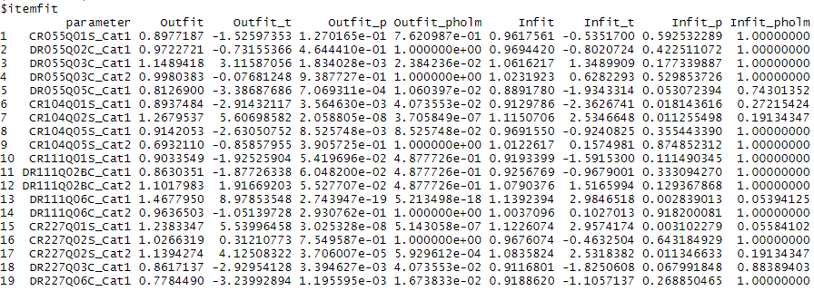
Fit Statistics

Slide 39
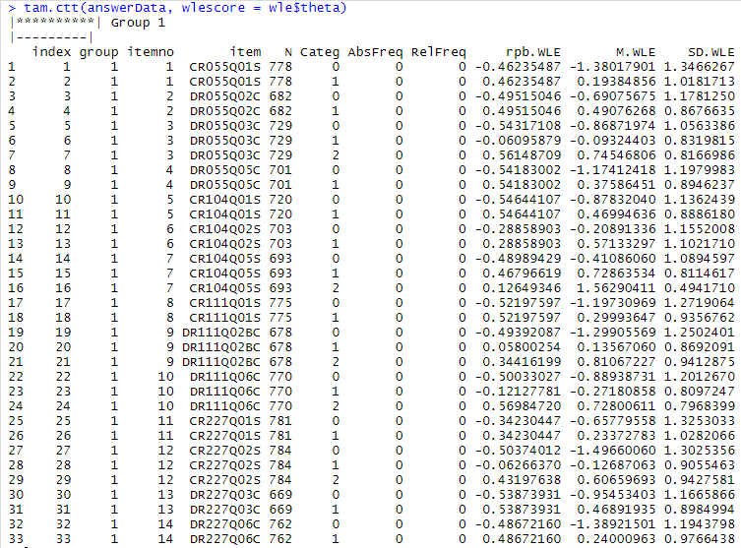
Classical Test Theory Measures

Slide 40
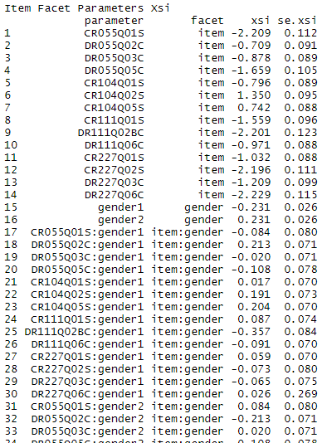
Differential Item Functioning (DIF)

Slide 41
Item Selection
Possible exclusion criteria:
Item fit > 1.15 (or 1.20)
Point-biserial correlation < .2 (or < .3)
DIF-logit > .25 (or .30)
Literature
Le, L. (2006). Analysis of differential item functioning. Presented at the annual conference of the American Educational Research Association (AERA), San Francisco, CA.
OECD. (2005). PISA 2003 technical report. Paris: OECD.
Olson, J. F., Martin, M. O., & Mullis, I. V. S. (Eds.). (2008). TIMSS 2007 technical report. Chestnut Hill, MA: TIMSS & PIRLS International Study Center, Lynch School of Education, Boston College.
Notes:
Technical Report PISA 2003 (p. 80)
For the purpose of this analysis, items were considered as weak when they had one or more of the following problems: negative or positive DIF more than 0.8; discrimination less than 0.30; and fit more than 1.15. These criteria, somewhat stricter than usual, were deliberately retained in order to identify not only items that had serious flaws, but also those that simply had a slightly imperfect functioning.
PISA 2006 field trial (Le, 2006. Analysis of Differential Item Functioning; p. 80)
For country and language DIF, item is flagged if the chi-square DIF test is significant at a 0.01 level and its absolute DIF value is greater than 0.30 logit; while with gender DIF, item is flagged if the chi-square DIF test is significant at a 0.01 level and its absolute DIF value is greater than 0.25 logit. The reason for setting an additional cut point of DIF is to take into account the DIF magnitude. Any statistic test would be significant if the sample size is large enough. And additionally, due to heterogenous sample problems, it is expected that in an international test, item parameter estimates would vary across countries or test languages (each may combine some countries) more than between male and female groups within a country. For example, Ercikan (1999) found that 41% of science items and 18% of mathematics items from TIMSS displayed DIF when the Canadian English and French examinees were compared.
TIMSS 2007 (p. 199; http://timss.bc.edu/timss2007/techreport.html)
• Item difficulty exceeds 95 percent in the sample as a whole.
• Item difficulty is less than 25 percent for four-option multiple-choice items in the sample as a whole.
• One or more of the distracter percentages is less than 10 percent.
• One or more of the distracter percentages is greater than the percentage for the correct answer or the point-biserial correlation for one or more of the distracters exceeds zero.
• Item discrimination (i.e., the point-biserial for the correct answer) is less than 0.2.
• Item discrimination does not increase with each score level (for constructed-response items with more than one score level).
• The Rasch difficulty estimate is easier or harder than the average across countries.
• Scoring reliability for the score points is less than 80 percent (for constructed-response items only).

Slide 42
Test Reliability
CTT Reliability
Cronbach’s alpha (should be above .8, above .7 might be alright…)
IRT Reliabilities
WLE reliability (does not consider multidimensional and regression information, usually close to Cronbach’s Alpha)
EAP/PV reliability (considers multidimensional and regression information)
Literature
OECD. (2017). PISA 2015 technical report. Paris: OECD.
Olson, J. F., Martin, M. O., & Mullis, I. V. S. (Eds.). (2008). TIMSS 2007 technical report. Chestnut Hill, MA: TIMSS & PIRLS International Study Center, Lynch School of Education, Boston College.

Slide 43
Estimation of Ability Scores
EAP Scores
Expected A Posteriori estimates
The mean of each student’s distribution of the Plausible Values
Are included in the model object
WLE Scores
Weighted Likelihood Estimates
Best point estimate for a student’s ability score
Are calculated via the function tam.wle()
Plausible Values
Include regression information for the calculation of group means that are free of estimation errors
Are calculated via the function tam.pv()

Slide 44
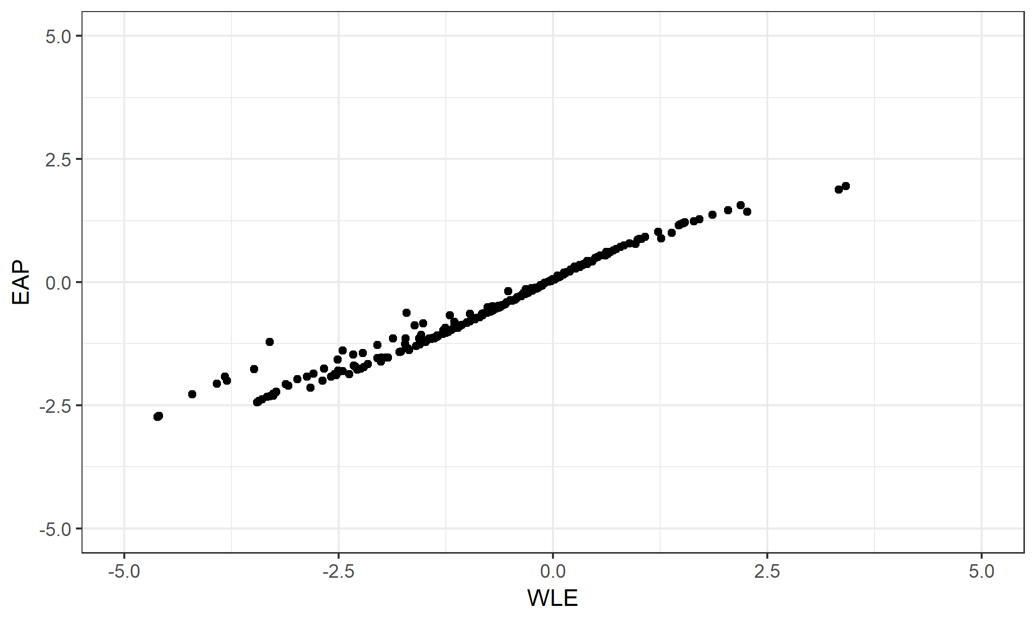
WLE vs. EAP

Slide 45
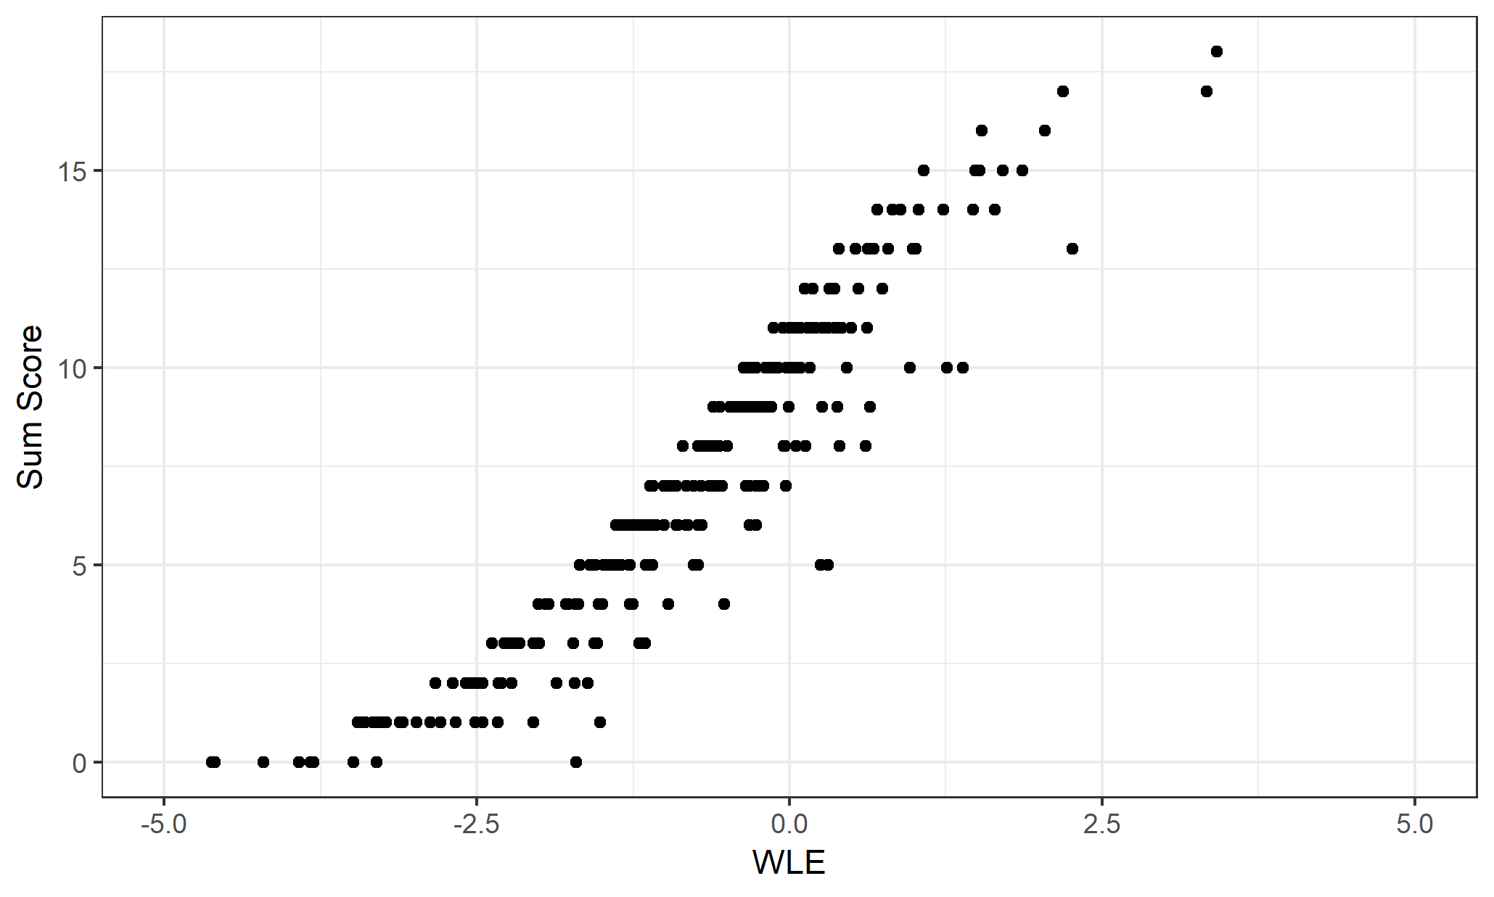
WLE vs. Sum Score

Slide 46
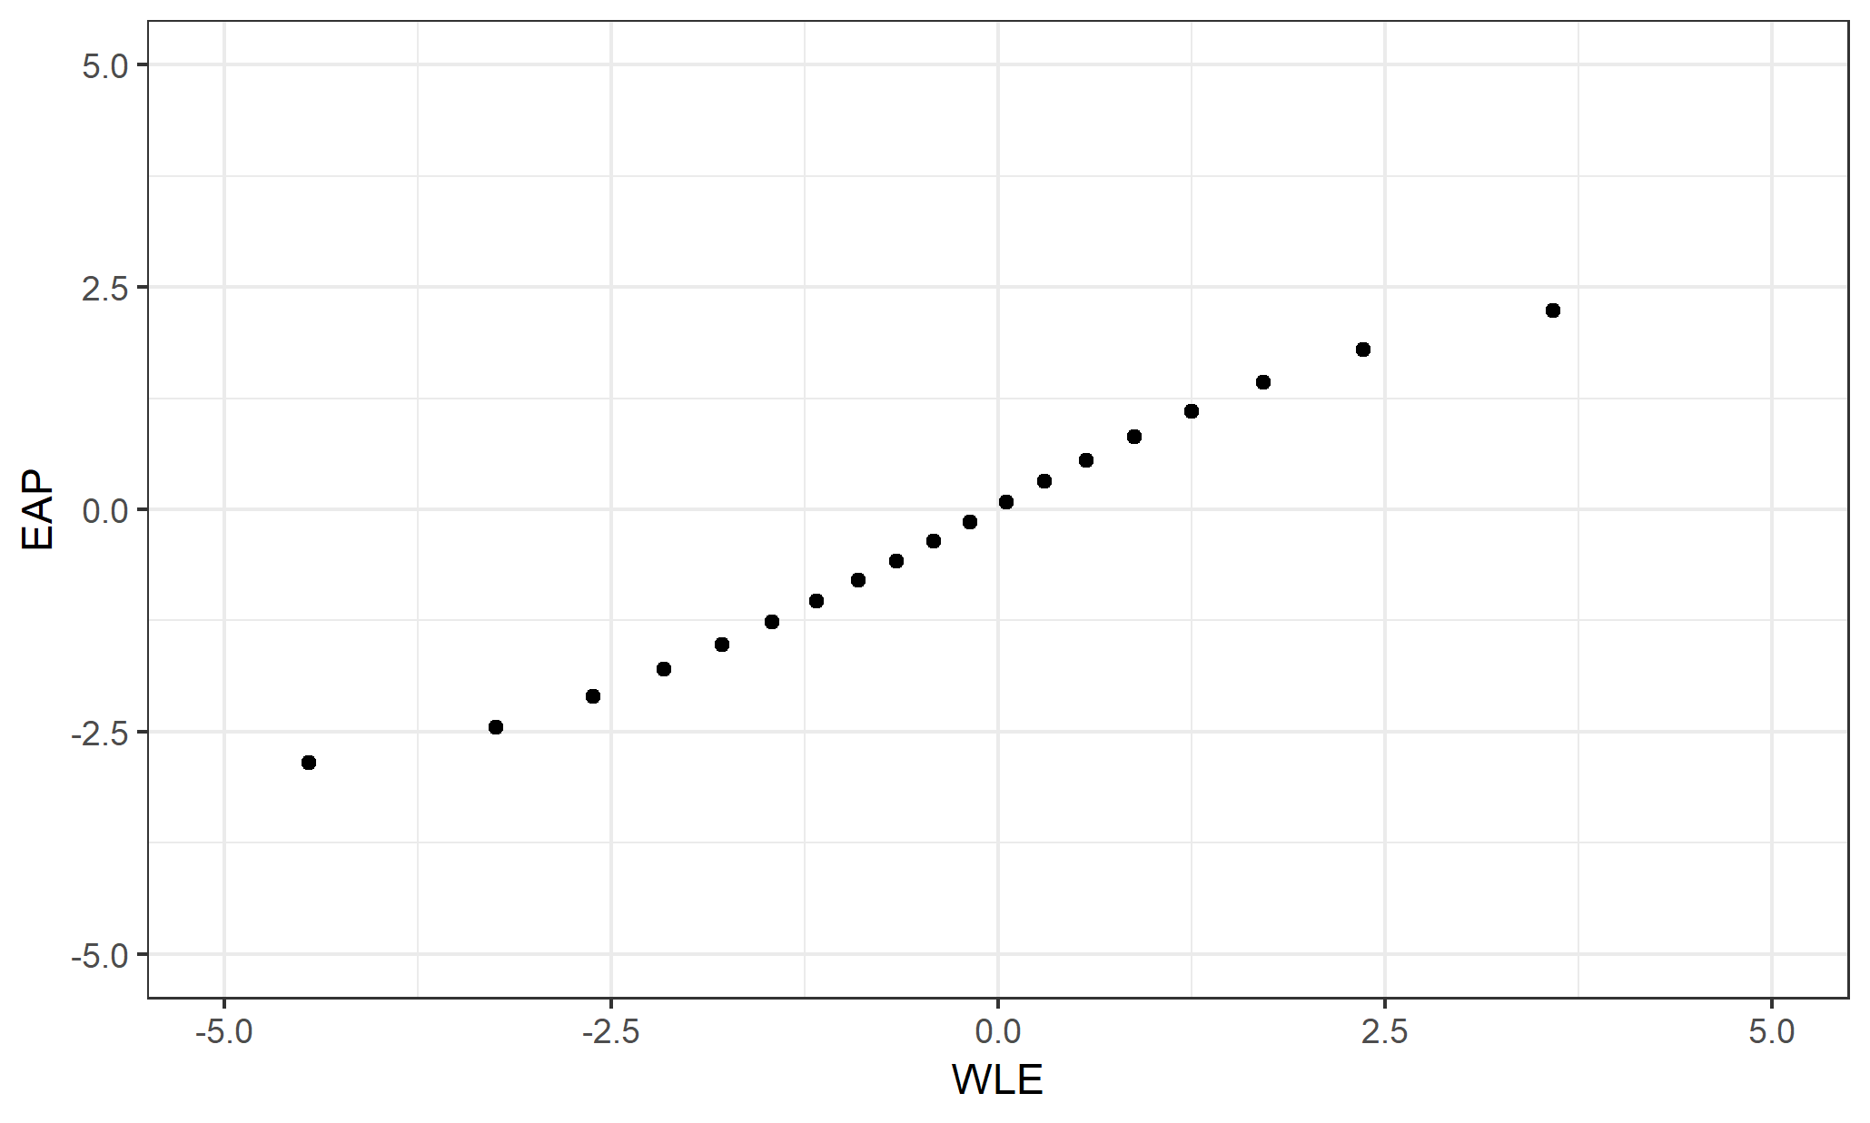
WLE vs. EAP – Without Missings

Slide 47
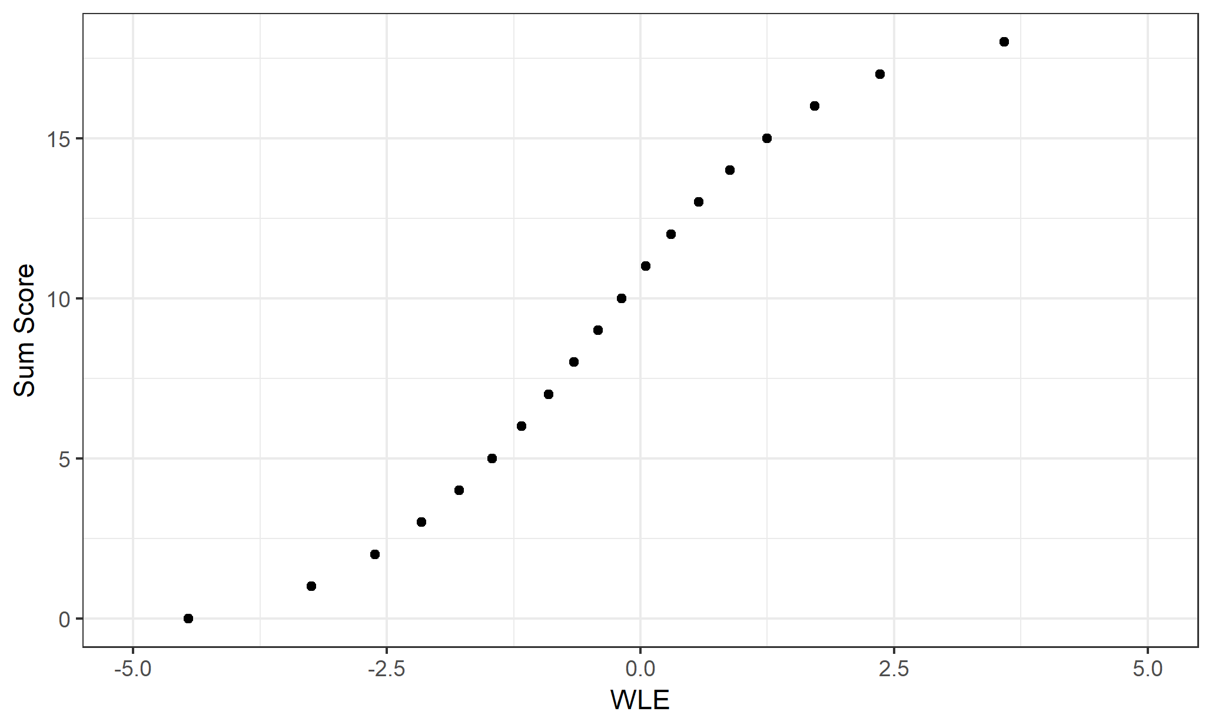
WLE vs. Sum Score – Without Missings

Slide 48
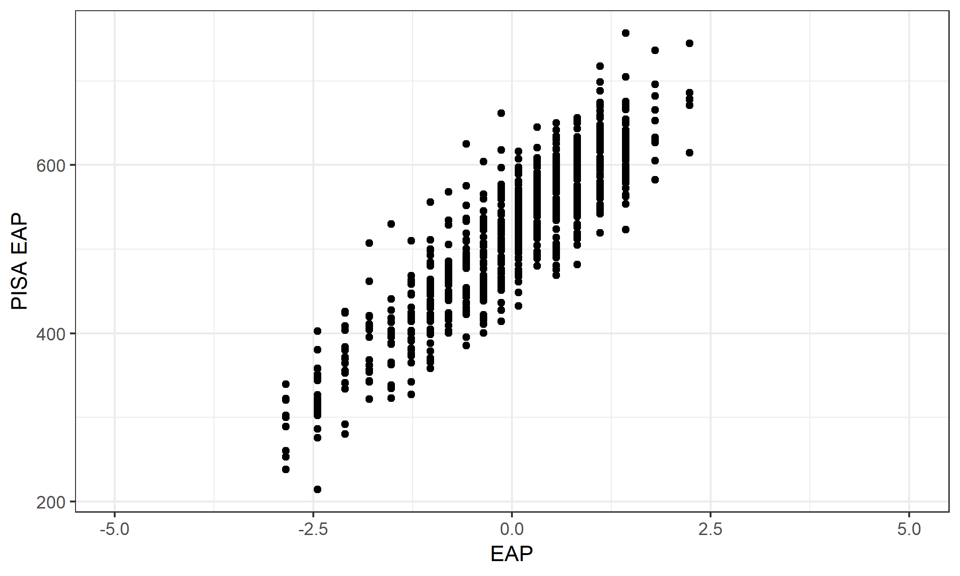
Comparison to the PISA EAP

Slide 49
IRT Model Estimation With Regression
To estimate correlations and group means without the estimation errors for the individual abilities
Correlation and group means will only be without estimation errors if the group information is included in the regression (“background”) model
More reliable estimation for data with missings at random due to the information used from the regression model

Slide 50
IRT Model Estimation With Regression
To estimate correlations and group means without the estimation errors for the individual abilities
Correlation and group means will only be without estimation errors if the group information is included in the regression (“background”) model
More reliable estimation for data with missings at random due to the information used from the regression model

